Slide 1
PCCAC - Panel Discussion - Board Members Tips and Best Practices
February 15, 2022
PCC EDUCATION PROGRAMMING
Notes:
Katrina

Slide 2
Housekeeping
Use the Chat box for your questions.
PPT presentation along with the recording will be posted on PostalPro.
Please ensure you are muted.
PCC EDUCATION PROGRAMMING
Notes:
Katrina

Slide 3
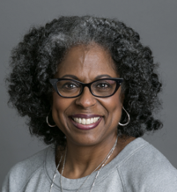
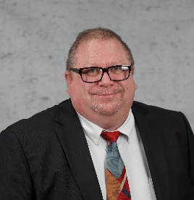
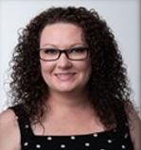
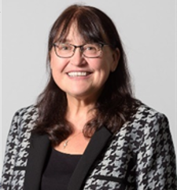
PCCAC Panelists
Kathy Hall
ATIME4Marketing
Industry Partner
Kathy@ATIME4Marketing.com
Joseph Banks
USMC: Marine Corps Installations East
Industry Partner
Joseph.Banks@usmc.mil
Rob Hanks
Suttle-Straus Inc.
Industry Partner
rob.hanks@suttle-straus.com
Monica O’Connor
Money Pages
Industry Partner
Monica.oconnor@moneypages.com
Suzi Oswald
SeaChange Print Innovations
Industry Partner
suzi.oswald@seachangeMN.com
Notes:
Katrina

Slide 4
Please Join Us - PCC Advisory Sub-Committees
Communications and Marketing
Education Programming
Membership Growth and Recruitment
Strategic Innovation & PCC Policy
Currently accepting new members – Industry and Postal
Free to join
Participate in Monthly meetings
Great Networking Opportunity
Make-a-Difference - Develop strategic initiatives to assist all 144 PCCs
Interested in joining or have any questions, please contact your Area Liaison or send an email to:
PCC@usps.gov
In the subject line type: PCCAC Sub-Committee
Notes:
Thank you

Slide 5
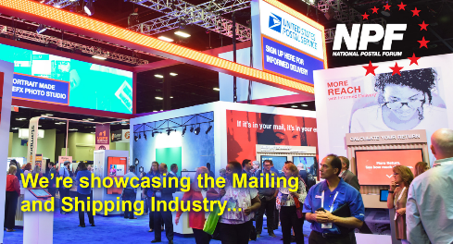
2022 National Postal Forum (NPF)

Slide 6
National PCC Week
Facing The Future Together
September 19 – 23, 2022
Form a Committee
Canvass possible venues for in-person or hybrid events – Outdoors
Ideally a location that does not require a deposit or guarantees your PCC a full refund
Prepare your budget
Recruit Sponsors
Communication collateral posted on PCC BlueShare site: https://ca.blueshare5.usps.gov/sites/igo/pcc/SitePages/Home.aspx

Slide 7
Questions and Answers
Notes:
Katrina

Slide 8
Thank You For All that You Do!
Notes:
Katrina

